Slide 1


Breaking Down Your
Website Quality Assessment
PREPARED FOR
[Client Name]
[Month] 2025

Slide 2


What’s in this document?
1
What “website quality” is and why it’s important.
2
What inputs go into the report and how we analyze them.
The outputs of the report and how we use them to execute your campaign.
3

Slide 3
What is “Website Quality”?
Search engines send traffic to websites they deem as “high quality”. That means a few things:
Sites that are coded and structured according to their webmaster guidelines.
Sites that are “popular”, i.e. getting mentioned across the web.
Sites that satisfy “searcher intent” through relevant and quality content.
Having low quality pages, content, poor structure and lack of web mentions causes Google to lose trust in your website and crawl, index and rank it less and less over time.
We assess quality of your website by looking at a number of different data inputs, including inbound links, titles, content depth, sales from organic traffic, keyword rankings and more.
Additional resources:
Google’s Quality Score (Moz)

Slide 4

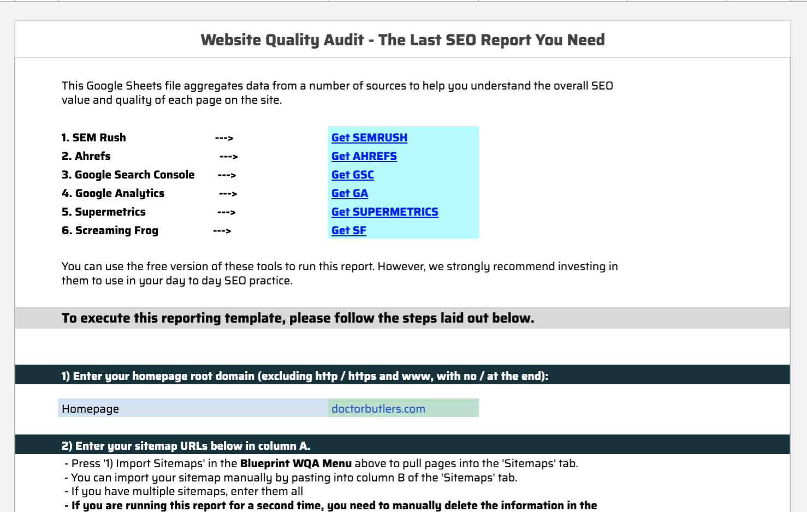
What goes into the “WQA”?
Our team built a tool using API data from 5 vital SEO data sources:
XML sitemaps - to get a list of URLs included in your Sitemap.
Screaming Frog - to get a full list of URLs and files uploaded to your site, page titles, metas, canonical tags and word count per page.
Ahrefs (Backlinks) - to get a list of the links pointing to your website and which pages they point to.
Ahrefs (Keywords) - to get your current keyword rankings and which pages they correlate to.
Google Analytics - to get sales, leads, and traffic data from search engines only.
Google Search Console - to get SERP impressions and page level click through rates in Google.
Our tool aggregates this data and allows us to assess quality metrics at the page level. From here, we can make a decision about what to do with every page on your site.

Slide 5

Tours, Activities & Attractions
What comes out of the “WQA” - Site Sections
Category Tag | Detail
Home Page | Primary landing page showcasing tour offerings, main navigation, and featured experiences.
Tour Page | Dedicated page for individual tours or activities, detailing itineraries, price, and booking.
Tour Category - Location | Listing of tours and activities grouped by geographical locations (city, state, country).
Tour Category - Activity | Grouped listings based on activity type (adventure, cultural, culinary, etc.).
Tour Category - Destination | Listing tours grouped by broader destination or attraction (e.g., Eiffel Tower, Grand Canyon).
Blog Post | Individual blog articles typically providing travel tips, guides, or experiences.
Blog Category | Sections grouping blog posts by themes or topics for better navigation.
Country Travel Guide | In-depth guide covering key travel info, top experiences, accommodations, and tips per country.
State Travel Guide | Guide specific to individual states or regions within a country.
City Travel Guide | Detailed guides dedicated to specific cities, including attractions, dining, accommodation.
Landmark/Attraction Guide | Dedicated informational page on notable landmarks or attractions.
Site Info | Required informational pages (e.g., Contact Us, FAQs, Terms & Conditions).
Author Page | Page dedicated to authors/bloggers highlighting their profile and posts they've written.
Media Gallery | Collection of photos/videos highlighting tours, activities, or attractions.
After the data is pulled and aggregated, the manual process begins. The first thing we do is group each page into a “section” (see chart for all the section categories we use). We do this for two reasons:
It allows us to segment the site and better prioritize pages / keywords to focus on.
It allows us to compare “apples to apples” (i.e. we don’t want to be comparing an FAQ page to a product page).
Notes:
Tours, Activities & Attractions

Slide 6
[ACTION TO TAKE - DELETE THIS SLDIE WHEN COMPLETE]
From the following set of slides (7-14), keep the slide that applies to your client’s Target Industry (what you selected in the “Getting Started” tab of the WQA, and delete all of the other “What comes out of the “WQA” - Site Sections” slides.

Slide 7
What comes out of the “WQA” - Site Sections
Tag | Detail
Product Page | This tag applies to eCommerce websites only. A product page is where they are selling the product (i.e. cart, price, etc).
Product Category | This tag applies to eCommerce websites only. A product category page is where the website lists their products based product type. For example, a website that sells shoes could have category pages for brands like Nike, Reebok, etc. Each of these pages will filter products to show them based on category.
Local Lander | This tag applies to local websites only. A local lander is the dedicated page to a given location. If the business has multiple locations, each store should have it’s own dedicated landing page. If the business only has 1 location, this can apply to the home page.
Lead Generation | This tag applies to pages on a site that are geared towards generating leads. For example, an attorney’s website could be trying to rank for keywords related to the different services they provide (DUI attorney, Criminal defense attorney, etc). Each of these keywords should have a dedicated landing page targeting those keywords.
Blog Post | This tag applies to blog posts. Some sites will have /blog/ or /news/ (or something similar) build into the URL structure.
Blog Category | This tag applies to categories of blog posts. These are generally used on bigger sites that publish a lot of content in order to better organize posts.
Resource / Guide | Similar to a blog post, but more in depth and robust. Resources or guides NOT connected to the blog, but instead are stand alone pages or site sections.
Site Info | This is a broad tag that applies to a wide range of pages. Essentially, these are the required pages to build out a full site but generally have little SEO (i.e. traffic potential) value. This can include about pages, cart pages, terms and services, contact page, shipping, FAQ and more.
After the data is pulled and aggregated, the manual process begins. The first thing we do is group each page into a “section” (see chart for all the section categories we use). We do this for two reasons:
It allows us to segment the site and better prioritize pages / keywords to focus on.
It allows us to compare “apples to apples” (i.e. we don’t want to be comparing an FAQ page to a product page).

Slide 8
Tours, Activities & Attractions
What comes out of the “WQA” - Site Sections
Category Tag | Detail
Home Page | Primary landing page showcasing tour offerings, main navigation, and featured experiences.
Tour Page | Dedicated page for individual tours or activities, detailing itineraries, price, and booking.
Tour Category - Location | Listing of tours and activities grouped by geographical locations (city, state, country).
Tour Category - Activity | Grouped listings based on activity type (adventure, cultural, culinary, etc.).
Tour Category - Destination | Listing tours grouped by broader destination or attraction (e.g., Eiffel Tower, Grand Canyon).
Blog Post | Individual blog articles typically providing travel tips, guides, or experiences.
Blog Category | Sections grouping blog posts by themes or topics for better navigation.
Country Travel Guide | In-depth guide covering key travel info, top experiences, accommodations, and tips per country.
State Travel Guide | Guide specific to individual states or regions within a country.
City Travel Guide | Detailed guides dedicated to specific cities, including attractions, dining, accommodation.
Landmark/Attraction Guide | Dedicated informational page on notable landmarks or attractions.
Site Info | Required informational pages (e.g., Contact Us, FAQs, Terms & Conditions).
Author Page | Page dedicated to authors/bloggers highlighting their profile and posts they've written.
Media Gallery | Collection of photos/videos highlighting tours, activities, or attractions.
After the data is pulled and aggregated, the manual process begins. The first thing we do is group each page into a “section” (see chart for all the section categories we use). We do this for two reasons:
It allows us to segment the site and better prioritize pages / keywords to focus on.
It allows us to compare “apples to apples” (i.e. we don’t want to be comparing an FAQ page to a product page).

Slide 9
OTA (Online Travel Agencies)
What comes out of the “WQA” - Site Sections
Category Tag | Detail
Home Page | Central page with search functionality for travel bookings (hotels, flights, packages).
Search Results Page | Results listing page following user queries for travel products/services.
Individual Listing Page | Detailed information page for a specific hotel, flight, car rental, or vacation package.
Destination Guide | Pages offering comprehensive guides to specific travel destinations.
Promotions/Deals Page | Pages highlighting current deals, discounts, or promotions available.
Blog Post | Individual articles providing travel tips, booking guides, and destination insights.
Blog Category | Organizes blog content into categories for easier browsing and navigation.
Travel Tips & Advice | Pages providing helpful booking and travel planning advice.
Resource / Guide | In-depth standalone content (e.g., booking strategies, travel hacks).
Author Page | Dedicated pages highlighting blog authors or travel experts.
Site Info | Required informational pages (terms, privacy policy, contact details, support).
FAQ / Customer Support Page | Informational pages providing answers to frequently asked customer queries.
After the data is pulled and aggregated, the manual process begins. The first thing we do is group each page into a “section” (see chart for all the section categories we use). We do this for two reasons:
It allows us to segment the site and better prioritize pages / keywords to focus on.
It allows us to compare “apples to apples” (i.e. we don’t want to be comparing an FAQ page to a product page).

Slide 10
Travel Management Companies (TMC)
What comes out of the “WQA” - Site Sections
Category Tag | Detail
Home Page | Main page providing overview of services, key benefits, and client testimonials.
Service Page | Individual pages describing specific TMC services (e.g., corporate travel management).
Industry Page | Dedicated pages showing expertise within specific industries (e.g., tech, healthcare).
Travel Management Platform | Pages describing software platforms or tools provided for travel management.
Client Success Story | Case studies or success stories highlighting client achievements through the TMC.
Blog Post | Individual blog articles covering topics relevant to managed travel and industry trends.
Blog Category | Categories grouping blog posts into common themes.
Resource / Guide | Robust standalone resources offering industry insights, travel policy templates, etc.
Destination Information | Informational pages about key destinations served, including local insights.
Author Page | Profiles highlighting individual contributors or authors of content.
Company Information | Pages providing background on the TMC company, team, history, and values.
Site Info | Informational pages with necessary details like privacy policies, FAQs, etc.
Contact / Booking Inquiry | Dedicated pages/forms for booking or service inquiries.
After the data is pulled and aggregated, the manual process begins. The first thing we do is group each page into a “section” (see chart for all the section categories we use). We do this for two reasons:
It allows us to segment the site and better prioritize pages / keywords to focus on.
It allows us to compare “apples to apples” (i.e. we don’t want to be comparing an FAQ page to a product page).

Slide 11
DMO (Destination Marketing Organizations)
What comes out of the “WQA” - Site Sections
Category Tag | Detail
Home Page | Main landing page showcasing highlights of the destination, news, and featured events.
Destination Overview Page | Broad introduction to the destination covering general travel info.
Region/Subregion Landing Page | Dedicated pages for subregions within the main destination.
Event Calendar Page | Pages highlighting events, festivals, and seasonal activities within the destination.
Things to Do | Comprehensive listing of attractions and activities.
Accommodation Overview Page | Listings or overviews of lodging options.
Local Business Directory | Directory of local businesses relevant to tourists.
Blog Post | Individual articles featuring destination highlights, experiences, and local tips.
Blog Category | Categories grouping blog content by topic or interest.
Travel Itinerary Ideas | Recommended itineraries or travel routes.
Media Gallery | Visual collections showcasing the destination.
Press Releases/Media | Pages providing updates, announcements, and media resources.
Author Page | Dedicated profiles for content creators or local experts.
Site Info | Informational pages with site policies, contacts, and general information.
After the data is pulled and aggregated, the manual process begins. The first thing we do is group each page into a “section” (see chart for all the section categories we use). We do this for two reasons:
It allows us to segment the site and better prioritize pages / keywords to focus on.
It allows us to compare “apples to apples” (i.e. we don’t want to be comparing an FAQ page to a product page).

Slide 12
Hotels, Resorts & Casinos
What comes out of the “WQA” - Site Sections
Category Tag | Detail
Home Page | Primary landing page highlighting the property, key amenities, and booking options.
Room/Accommodation Page | Specific page detailing each room type or accommodation available.
Amenities/Facilities Page | Pages highlighting available hotel amenities or facilities.
Dining/Restaurant Page | Information about on-site dining options.
Entertainment & Casino Page | Pages specifically detailing entertainment venues or casino facilities.
Offers & Packages Page | Promotional offers, discounts, and bundled experiences.
Destination Information | Information about the surrounding area or attractions near the property.
Events & Meetings Page | Facilities and services offered for events, conferences, or weddings.
Blog Post | Articles on hotel news, travel advice, and local attractions.
Gallery Page | Photos and videos showcasing the property.
Site Info | Essential informational pages (e.g., policies, terms).
Author Page | Information about content creators or contributors.
After the data is pulled and aggregated, the manual process begins. The first thing we do is group each page into a “section” (see chart for all the section categories we use). We do this for two reasons:
It allows us to segment the site and better prioritize pages / keywords to focus on.
It allows us to compare “apples to apples” (i.e. we don’t want to be comparing an FAQ page to a product page).

Slide 13
Vacation Rentals
What comes out of the “WQA” - Site Sections
Category Tag | Detail
Home Page | Main page showcasing featured rentals, locations, and easy search options.
Rental Listing Page | Individual detailed pages for specific rental properties.
Rental Category | Pages grouping rentals by type (e.g., beachfront, mountain cabin, city apartment).
Destination Overview Page | Information pages about rental destinations highlighting local attractions and activities.
Host Profile Page | Profile pages detailing rental property hosts and reviews.
Rental Policies / Guidelines | Informational pages outlining rental policies, terms, and guidelines.
Blog Post | Individual articles offering travel tips, rental guides, and local insights.
Blog Category | Categories organizing blog posts into clear themes.
Local Travel Guide | Comprehensive guides specific to rental locations.
FAQ / Help Page | Informational pages answering common guest queries.
Site Info | Standard informational pages (e.g., privacy policy, terms of service, contact information).
Author Page | Pages showcasing authors or contributors of site content.
Media Gallery | Visual galleries showcasing property interiors, exteriors, and surrounding locations.
After the data is pulled and aggregated, the manual process begins. The first thing we do is group each page into a “section” (see chart for all the section categories we use). We do this for two reasons:
It allows us to segment the site and better prioritize pages / keywords to focus on.
It allows us to compare “apples to apples” (i.e. we don’t want to be comparing an FAQ page to a product page).

Slide 14
Multi-Day Tours
What comes out of the “WQA” - Site Sections
Category Tag | Detail
Home Page | Overview page showcasing multi-day tours, featured trips, and customer testimonials.
Multi-Day Tour Page | Pages dedicated to individual multi-day tour details including itinerary, inclusions, pricing.
Multi-Day Tour Category | Pages categorizing tours by region, duration, or theme (adventure, cultural, family, etc.).
Tour Itinerary Page | Detailed daily breakdown of activities for each tour.
Departure Schedule | Schedule of upcoming tour departures and availability.
Traveler Stories & Testimonials | Pages highlighting customer experiences and reviews.
Destination Guide | Comprehensive informational pages about tour destinations.
Resource / Guide | Robust standalone guides (packing lists, preparation advice, travel tips).
Blog Post | Individual articles about destinations, experiences, travel advice.
Blog Category | Categories grouping blog articles by theme or topic.
Site Info | Essential informational pages (privacy policy, booking terms, cancellation policy).
Author Page | Profiles showcasing content contributors.
Media Gallery | Photos/videos highlighting experiences from tours.
After the data is pulled and aggregated, the manual process begins. The first thing we do is group each page into a “section” (see chart for all the section categories we use). We do this for two reasons:
It allows us to segment the site and better prioritize pages / keywords to focus on.
It allows us to compare “apples to apples” (i.e. we don’t want to be comparing an FAQ page to a product page).

Slide 15
Charter Company
What comes out of the “WQA” - Site Sections
Category Tag | Detail
Home Page | Landing page highlighting fleet options, popular charter routes, and booking inquiries.
Charter Service Page | Individual pages detailing each charter service offered (aircraft, yacht, buses).
Charter Fleet Detail Page | Dedicated pages for each specific vessel or vehicle in the fleet.
Charter Route/Itinerary Page | Detailed pages for charter routes, itineraries, or popular destinations.
Charter Destination Guide | Informational pages about destinations accessible via charters.
Pricing & Packages Page | Pages clearly outlining pricing structures and charter packages.
Traveler Testimonials/Reviews | Pages displaying reviews and customer feedback.
Safety Information Page | Informational content covering safety protocols and certifications.
Blog Post | Individual articles sharing charter tips, destination highlights, or company news.
Blog Category | Categories for organizing blog posts into clear topics.
Resource / Guide | Standalone content guides providing FAQs, booking tips, and travel recommendations.
Site Info | Essential information (privacy policy, terms of service, contact).
Author Page | Profiles for authors or contributors to the site.
Gallery Page | Visual content showcasing the fleet, destinations, or charter experiences.
After the data is pulled and aggregated, the manual process begins. The first thing we do is group each page into a “section” (see chart for all the section categories we use). We do this for two reasons:
It allows us to segment the site and better prioritize pages / keywords to focus on.
It allows us to compare “apples to apples” (i.e. we don’t want to be comparing an FAQ page to a product page).

Slide 16
Travel Media Publishers
What comes out of the “WQA” - Site Sections
Category Tag | Detail
Home Page | Main content hub highlighting recent articles, trending content, and featured stories.
Travel Article/Post | Individual articles or editorial content pieces about travel destinations, tips, or trends.
Article Category | Categories grouping articles based on common themes or topics (destinations, guides, tips).
Destination Guide | Informational and inspirational guides covering various travel locations.
Travel Tips & Advice Page | Dedicated pages providing practical travel advice, hacks, and recommendations.
Special Feature / Editorial Series | In-depth series or featured stories on specific themes or destinations.
Video/Media Content Page | Page specifically for video-based content or multimedia presentations.
Author Profile Page | Dedicated pages highlighting contributing authors or content creators.
Sponsored Content Page | Clearly marked pages featuring sponsored or promotional content.
Blog Category | Organization of blog posts into clear topic-based groups.
Newsletter/Subscription Landing Page | Pages encouraging subscription or sign-up for newsletters and updates.
Site Info | Standard informational content (terms, privacy policy, contact details).
Media Kit/Advertise Page | Page containing advertising options, rates, and media information for sponsors.
After the data is pulled and aggregated, the manual process begins. The first thing we do is group each page into a “section” (see chart for all the section categories we use). We do this for two reasons:
It allows us to segment the site and better prioritize pages / keywords to focus on.
It allows us to compare “apples to apples” (i.e. we don’t want to be comparing an FAQ page to a product page).

Slide 17
Travel - Ancillaries
What comes out of the “WQA” - Site Sections
Category Tag | Detail
Home Page | Main page highlighting ancillary products, search and selection tools, and featured offers.
Product Page | Pages dedicated to specific ancillary products (insurance plans, SIM cards, etc.).
Product Category | Grouping pages by ancillary product types or coverage options.
Destination Coverage Information | Informational pages detailing product applicability by destination or region.
Comparison Page | Pages enabling users to compare ancillary products side-by-side.
Promotions & Discounts Page | Pages featuring current promotions, deals, or special offers.
How-To Guide & FAQ Page | Pages providing detailed instructions, FAQs, and support for ancillary products.
Customer Support Page | Dedicated page for customer inquiries, contact information, and support resources.
Blog Post | Articles on travel safety, connectivity tips, and product reviews.
Blog Category | Categories to organize blog articles.
Resource / Guide Page | Standalone content pages providing detailed advice or recommendations.
Site Info | Essential informational pages (terms of service, privacy policy).
Author Page | Profiles for authors or content creators.
After the data is pulled and aggregated, the manual process begins. The first thing we do is group each page into a “section” (see chart for all the section categories we use). We do this for two reasons:
It allows us to segment the site and better prioritize pages / keywords to focus on.
It allows us to compare “apples to apples” (i.e. we don’t want to be comparing an FAQ page to a product page).

Slide 18
Ground Transportation
What comes out of the “WQA” - Site Sections
Category Tag | Detail
Home Page | Central page showcasing transportation options, rental booking tools, and promotions.
Vehicle/Product Listing Page | Dedicated pages detailing specific vehicles or transportation products.
Vehicle Type Category | Pages grouping vehicles by type (economy, luxury, SUV, shuttle, etc.).
Destination Pickup/Drop-off Information | Information about transportation logistics specific to locations.
Pricing & Booking Page | Clear information on pricing structures, availability, and booking instructions.
Service Policies & Guidelines | Informational pages about service policies, rental agreements, and procedures.
Traveler Reviews & Testimonials | Customer feedback and testimonials about transportation experiences.
Blog Post | Articles about transportation tips, destination travel advice, or company updates.
Blog Category | Categories organizing blog content clearly by topic.
Destination Travel Guide | Guides offering transportation-related advice or destination information.
FAQ/Help Page | Detailed FAQ pages addressing common customer questions.
Site Info | Informational pages required for compliance (privacy policy, contact info).
Author Page | Dedicated profiles for content contributors.
After the data is pulled and aggregated, the manual process begins. The first thing we do is group each page into a “section” (see chart for all the section categories we use). We do this for two reasons:
It allows us to segment the site and better prioritize pages / keywords to focus on.
It allows us to compare “apples to apples” (i.e. we don’t want to be comparing an FAQ page to a product page).

Slide 19
Travel - Ecom (Travel Gear, Clothing & Products)
What comes out of the “WQA” - Site Sections
Category Tag | Detail
Home Page | Central page showcasing transportation options, rental booking tools, and promotions.
Vehicle/Product Listing Page | Dedicated pages detailing specific vehicles or transportation products.
Vehicle Type Category | Pages grouping vehicles by type (economy, luxury, SUV, shuttle, etc.).
Destination Pickup/Drop-off Information | Information about transportation logistics specific to locations.
Pricing & Booking Page | Clear information on pricing structures, availability, and booking instructions.
Service Policies & Guidelines | Informational pages about service policies, rental agreements, and procedures.
Traveler Reviews & Testimonials | Customer feedback and testimonials about transportation experiences.
Blog Post | Articles about transportation tips, destination travel advice, or company updates.
Blog Category | Categories organizing blog content clearly by topic.
Destination Travel Guide | Guides offering transportation-related advice or destination information.
FAQ/Help Page | Detailed FAQ pages addressing common customer questions.
Site Info | Informational pages required for compliance (privacy policy, contact info).
Author Page | Dedicated profiles for content contributors.
After the data is pulled and aggregated, the manual process begins. The first thing we do is group each page into a “section” (see chart for all the section categories we use). We do this for two reasons:
It allows us to segment the site and better prioritize pages / keywords to focus on.
It allows us to compare “apples to apples” (i.e. we don’t want to be comparing an FAQ page to a product page).

Slide 20
What comes out of the “WQA” - URL Actions
URL Action | Detail
1. Leave As Is | No action needed on the page. You can use this tag for pages performing well or for pages you simply want to ignore because they are irrelevant to your SEO (contact page, etc).
2. Update "On Page" | Use this when you want to review the keywords, titles, meta and on page content for that URL. This can also be used for evergreen, cornerstone blog posts / resource guides that you want to update with more recent information. URLs assigned this URL Action are moved into the “KW Research for Existing Pages & On-Page recommendations” deliverable.
3. Target w/ Links | If everything checks out with the page but it doesn’t have rankings, the best solution is to target it with links. You can also double up to “Update On Page” and “Target w/ Links” using both action columns.
4. 301 (Redirect) | When a page serves no value to the website (both for search engines and users) you will want to 301 redirect it into a more relevant page.
5. Canonicalize | If you have similar pages targeting the same topic but you NEED both pages (i.e. you don’t want to remove the page), set a canonical tag that points to the page you want to rank.
6. Block Crawl | If you have a group of pages that serve NO value to search engines (but have value to website visitors), the best option is to block that section from being crawled. This works best when pages are grouped by URL structure (i.e. /archives/).
7. No Index | If you want to stop Google from indexing a low quality page, use this tag. Blocking Crawl is reserved for a number of pages or site sections, No Index is reserved for individual or stand alone pages.
8. Content Analysis | For content (blogs or resources) where there is potential value in updating & optimizing the content for search. URLs assigned this URL Action are moved into the “Content Analysis” deliverable.
9. 410 Delete | If a page no longer serves a purpose to the website, has NO links, NO traffic and the keywords are no longer relevant, we can delete it.
10. Find and Replace URL | If a “301” page is discovered during the crawl, and the internal link can be replaced with its “Final URL” to remove an extra step for crawlers to move through, we want to find that URL and replace it with its final location.
11. Find and Remove URL | If a “404” page is discovered and there is no suitable replacement for the page, we want to find where the broken link is located and remove the link from the site.
After each page on the site is classified into a category, we can quickly assess each page for quality (by section). We assign each page a “URL Action” (see chart to the right for full list and explanations of each). These “URL Actions” dictate:
Which pages to clean up (i.e. redirect, NOINDEX, etc)
Which pages have no potential for traffic and to ignore (i.e. contact page)
Which pages we will focus on for the campaign (i.e. perform KW research, update “on page” elements, target with links).

Slide 21
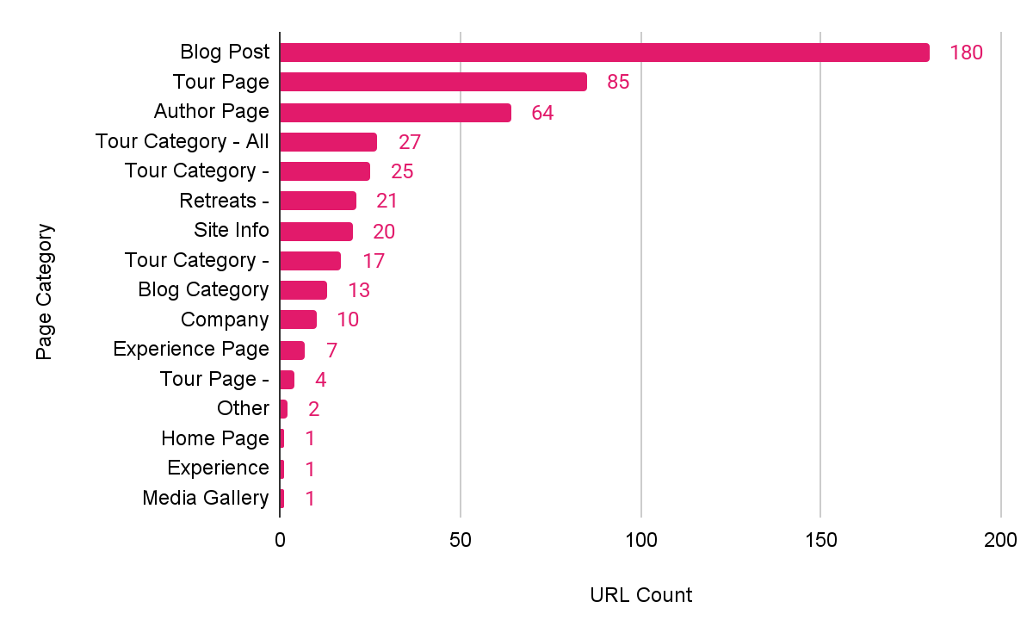
Site Structure Overview
Site Structure
In this section, provide any notable insights into the structure of the clients site.
Are they focusing in areas/producing too much content in categories that don’t produce bookings?
Are they too heavy in pages that shouldn’t be indexed?
Or are they structuring their site well, and their appears to be a healthy number of Lead Gen/Product pages, in addition to Resources and Blog Posts?
Notes:
Link to Chart: https://docs.google.com/spreadsheets/d/1CNChHS8-gO7lqbSYQlH-LxSfJwzyimmYhFJGy6CzZ-g/edit?gid=1618588231#gid=1618588231

Slide 22
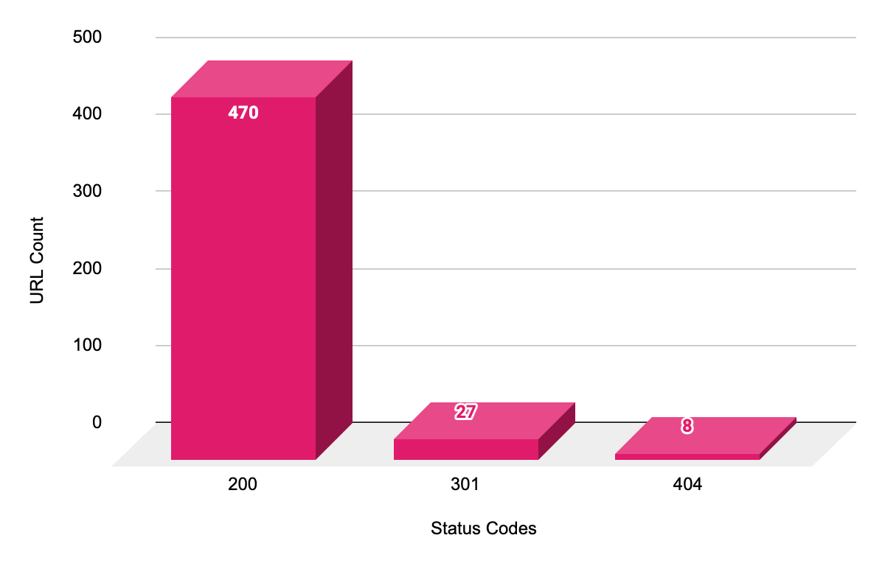
Site Structure Overview
Status Codes Heading
In this section, provide any notable insights into accessibility of their site crawl:
If there are only 200 Status pages (rare but possible), this slide may be useless, and you may not need to have a chart/highlight this on its own slide. Consider mentioning this in another slide
If there are a large number of 301s - call this out, and provide context on why this is an issue
If there are a large number of 404s, explain the significance
If there a large number of Forbidden responses or Time Out Status, explain this issue
Notes:
Link to Chart: https://docs.google.com/spreadsheets/d/1CNChHS8-gO7lqbSYQlH-LxSfJwzyimmYhFJGy6CzZ-g/edit?gid=1975750220#gid=1975750220

Slide 23
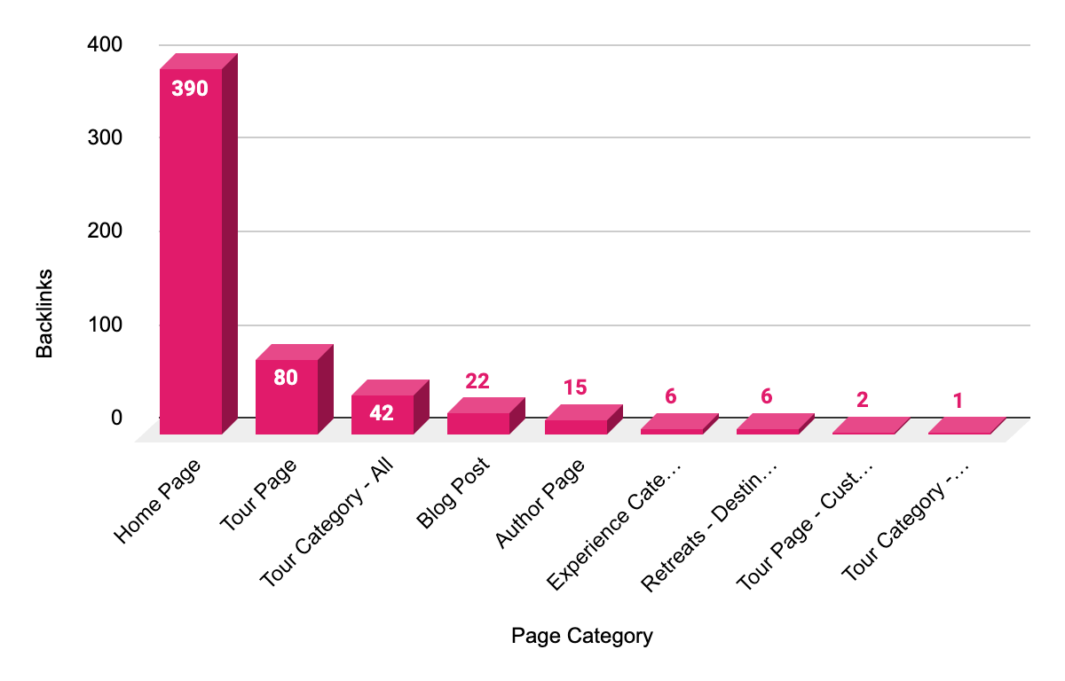
Site Authority Overview
Backlinks by Category
Provide insights into the distribution of backlinks across various sections of the site.
Highlight how Link Authority gaps could be strong causes of underperformance.
Highlight if there is large link gap for areas of the site that drive bookings, if applicable.
If possible/applicable, reference Link Gap findings from the Sales Proposal to identify notable gaps (Ex. if target term needs as many backlinks as an entire section of the client’s site currently has.
Notes:
Link to Chart: https://docs.google.com/spreadsheets/d/1CNChHS8-gO7lqbSYQlH-LxSfJwzyimmYhFJGy6CzZ-g/edit?gid=1307378891#gid=1307378891

Slide 24
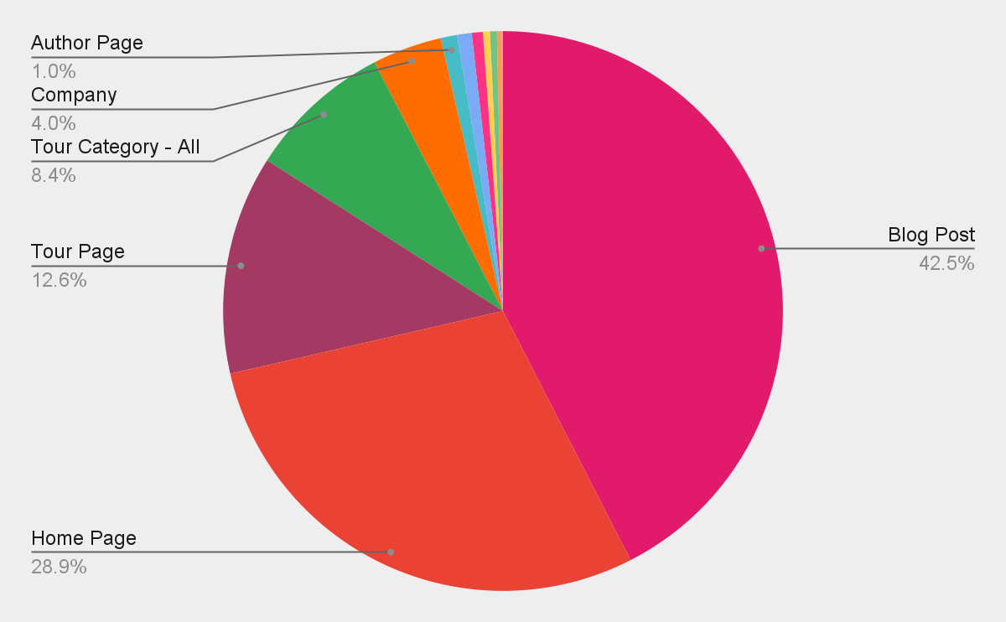
Organic Performance - Traffic
Sessions by Category
In this section, provide any notable insights into organic traffic by site section.
What section is bringing in the most traffic? Is this branded or non-branded?
Does performance by site section correlate with the number of pages in each section?
Notes:
Link to Chart: https://docs.google.com/spreadsheets/d/1CNChHS8-gO7lqbSYQlH-LxSfJwzyimmYhFJGy6CzZ-g/edit?gid=92554350#gid=92554350

Slide 25
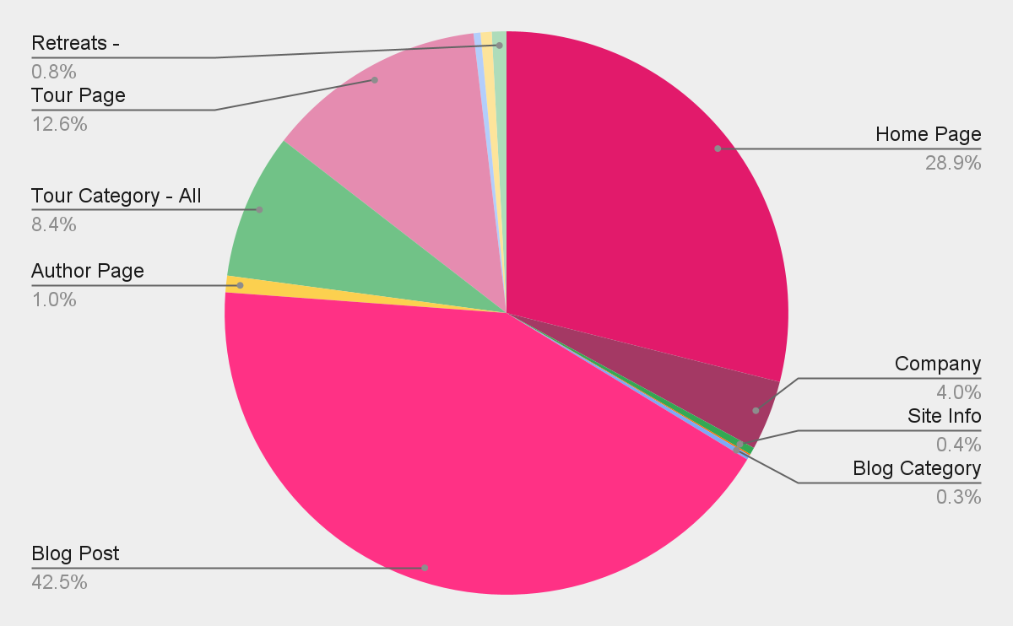
Site Structure Overview
Indexable URLs vs URLs in the XML Sitemap
Number of URLs in the XML Sitemap vs Number of Indexable URLs that are not.

Slide 26
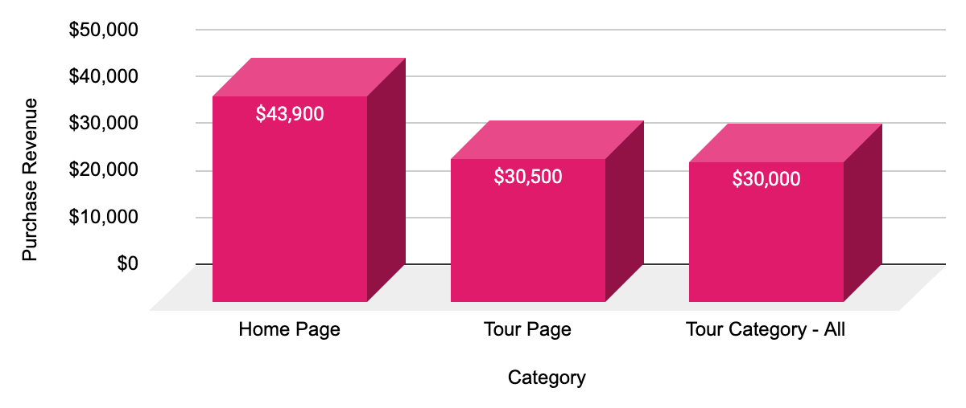
Organic Performance - Bookings
Revenue Heading
In this section, provide any notable insights into:
What sections of the site are generating revenue
Is revenue generation split up between several page types, or is there a select few responsible for generating revenue from organic?
Are any of their blogs at this time generating revenue?
For the top 5 pages generating revenue, is there a page generating a significant amount in comparison to the entire site?
Top 5 Pages by Revenue | Purchase Revenue
https://modernadventure.com/ | $43,900
https://modernadventure.com/our-trips/ | $30,000
https://modernadventure.com/our-trips/oaxaca-with-erik-anderson/ | $9,500
https://modernadventure.com/our-trips/oaxaca-with-heath-ceramics/ | $5,500
https://modernadventure.com/our-trips/oaxaca-with-fany-gerson/ | $3,000
Notes:
Link to Revenue by Category Bar Chart: https://docs.google.com/spreadsheets/d/1CNChHS8-gO7lqbSYQlH-LxSfJwzyimmYhFJGy6CzZ-g/edit?gid=1065132173#gid=1065132173
Link to Top 5 Pages by Revenue Table: https://docs.google.com/spreadsheets/d/1CNChHS8-gO7lqbSYQlH-LxSfJwzyimmYhFJGy6CzZ-g/edit?gid=1611787336#gid=1611787336

Slide 27
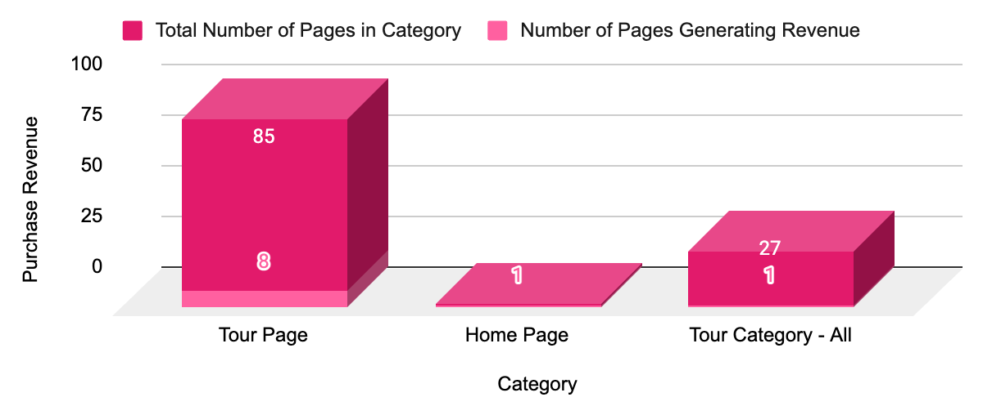
Organic Performance - Bookings
Pages Driving Revenue
In this section, provide any notable insights into:
Of the sections of the site driving revenue from organic, how many pages are actually driving revenue? What percentage?
Is it a select few pages that are actually ranking and driving revenue, or is it well mixed?
Notes:
Link to # of Pages Driving Revenue by Category Bar Chart: https://docs.google.com/spreadsheets/d/1CNChHS8-gO7lqbSYQlH-LxSfJwzyimmYhFJGy6CzZ-g/edit?gid=1428278599#gid=1428278599

Slide 28

What are your outcomes?
Important Learnings and Insights:
Next slide will correlate site sections to phases of the Traveler Intent Journey, to help identify where the client’s site is meeting content goals, and where there are large gaps in the customer journey.

Slide 29
What are your outcomes?
Important Learnings and Insights:
X 301 URLs and XX 404 links found on the website.
Give the action task to either replace or remove URL.
Very strong backlink profile with 99% of DoFollow links pointed at the homepage (XXX links).
We identified the following items for direct action:
XX pages to Find and Remove the URL
Many of these links are located on this page https://www.gracerosefarm.com/blogs/news/extending-our-season
XX pages to Find and Replace the URL
Many of these links are located on this page: https://www.gracerosefarm.com/blogs/news/getting-to-know-our-customers
XX pages to Optimize On-Page SEO
Product Category pages and important website pages
XX pages to Content Analysis
Blog posts targeting highly search topics
Notes:
Full WQA:

Slide 30
What’s next?
Improving existing assets:
URL Actions: Implement technical changes (no index, 301 redirect, etc.)
Keyword Research: Intent mapping for pages marked “Update On Page”
On-Page Recommendations: Improvements (titles, metas, internal links, body text, schema) for pages marked “Update On Page”
Content Analysis: Improve and update blog post pages with potential to rank for high volume keywords and to merge pages with very similar content
Creating new assets:
[Replace or remove this section as needed]

Slide 31

THANK YOU!
www.propellic.com

Slide 32
Tours, Activities & Attractions
What comes out of the “WQA” - Site Sections
Category Tag | Detail
Home Page | Primary landing page showcasing tour offerings, main navigation, and featured experiences.
Tour Page | Dedicated page for individual tours or activities, detailing itineraries, price, and booking.
Tour Category - Location | Listing of tours and activities grouped by geographical locations (city, state, country).
Tour Category - Activity | Grouped listings based on activity type (adventure, cultural, culinary, etc.).
Tour Category - Destination | Listing tours grouped by broader destination or attraction (e.g., Eiffel Tower, Grand Canyon).
Blog Post | Individual blog articles typically providing travel tips, guides, or experiences.
Blog Category | Sections grouping blog posts by themes or topics for better navigation.
Country Travel Guide | In-depth guide covering key travel info, top experiences, accommodations, and tips per country.
State Travel Guide | Guide specific to individual states or regions within a country.
City Travel Guide | Detailed guides dedicated to specific cities, including attractions, dining, accommodation.
Landmark/Attraction Guide | Dedicated informational page on notable landmarks or attractions.
Site Info | Required informational pages (e.g., Contact Us, FAQs, Terms & Conditions).
Author Page | Page dedicated to authors/bloggers highlighting their profile and posts they've written.
Media Gallery | Collection of photos/videos highlighting tours, activities, or attractions.
After the data is pulled and aggregated, the manual process begins. The first thing we do is group each page into a “section” (see chart for all the section categories we use). We do this for two reasons:
It allows us to segment the site and better prioritize pages / keywords to focus on.
It allows us to compare “apples to apples” (i.e. we don’t want to be comparing an FAQ page to a product page).
Notes:
Tours, Activities & Attractions

